Slide 1
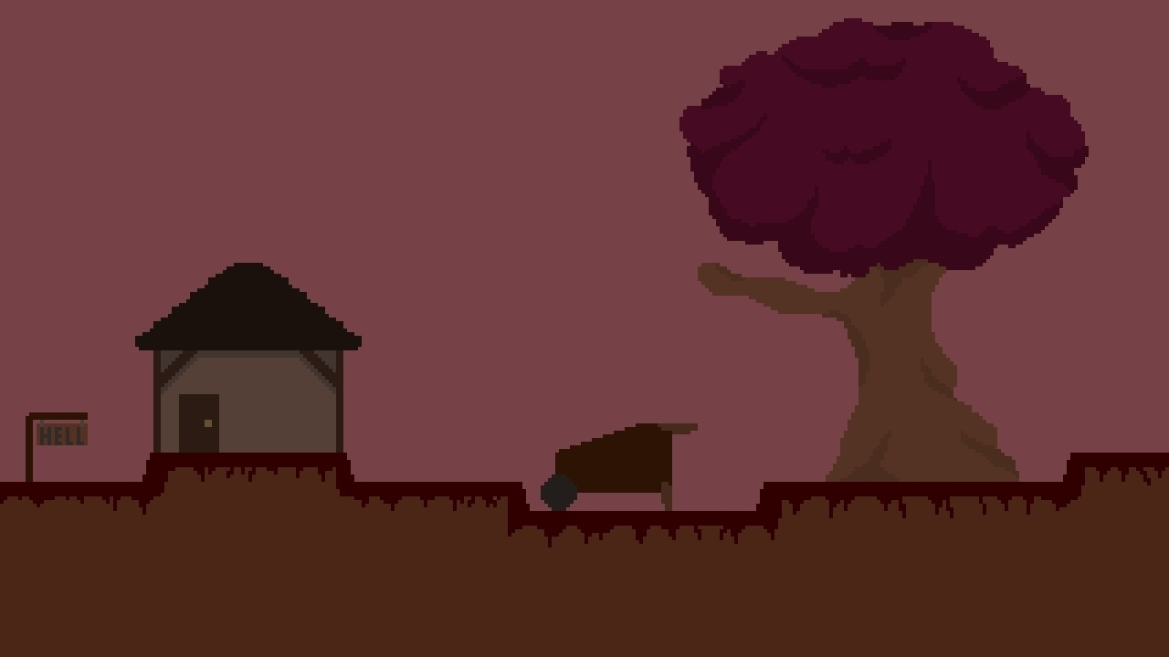
Satan’s Soup
Satan’s Soup
From the Satan’s Soup team-
Thai,Madison,Anabel,and Carla
From the Satan’s Soup team-
Thai,Garret,Anabel,and Carla

Slide 2

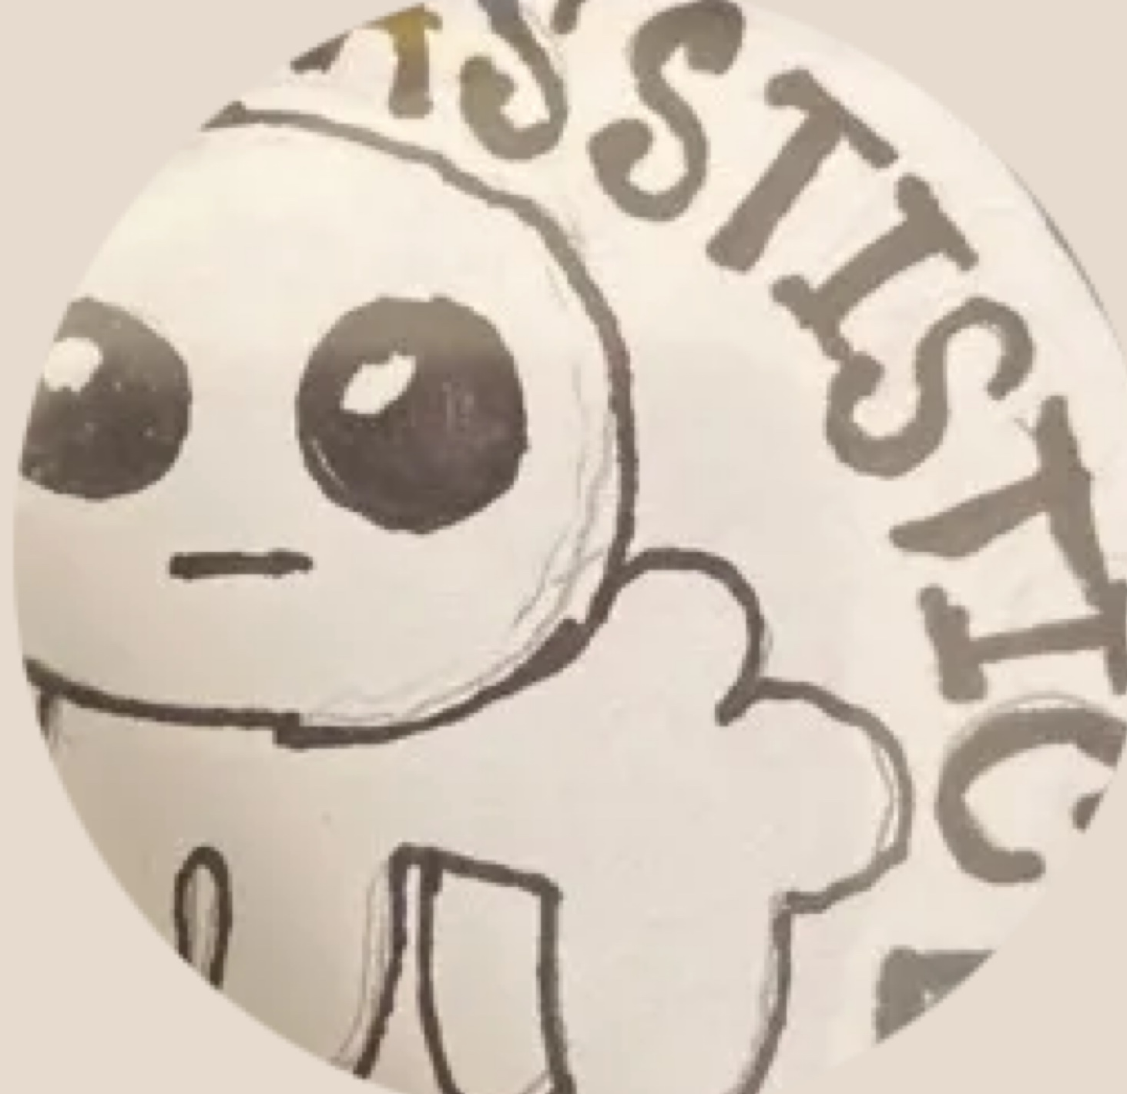
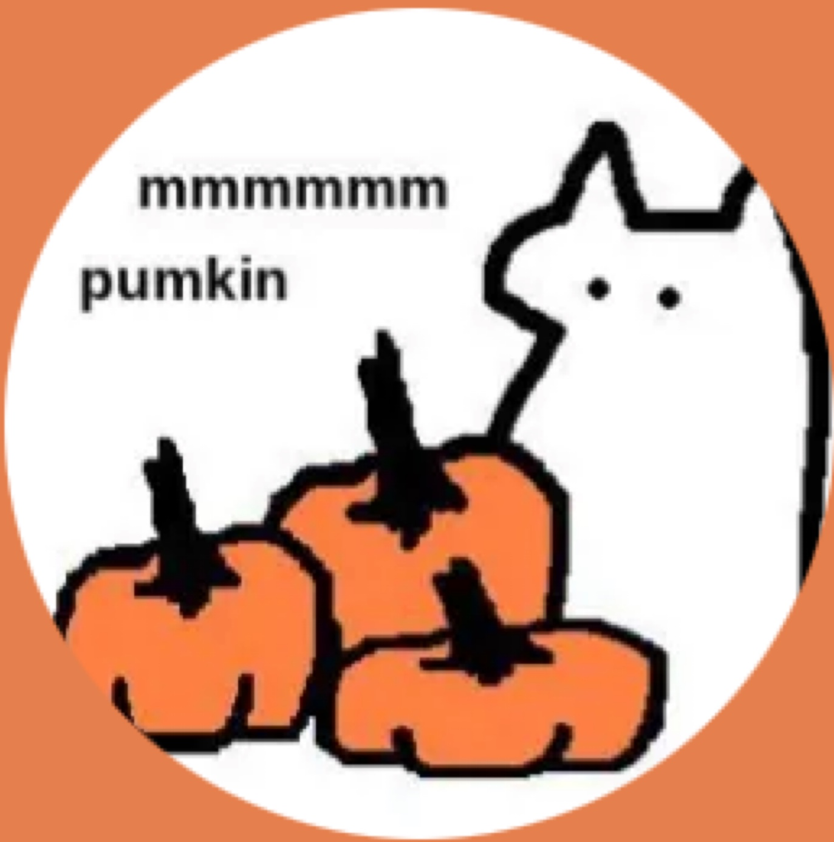

The Team
-Thai- Ground assets, AR Rock Paper Scissors script, AR cards
-Garret- Managing scripts, AR assistance
-Anabel- Background Design, collectable sprites
-Carla- Player/Enemy design, Animations, AR setup

Slide 3
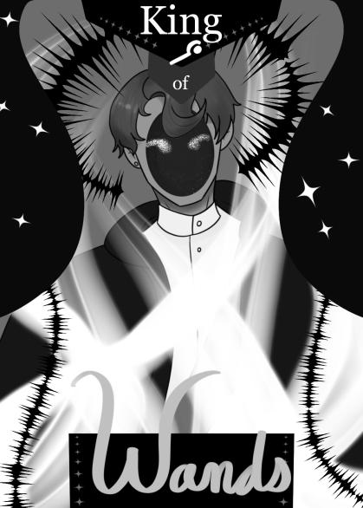
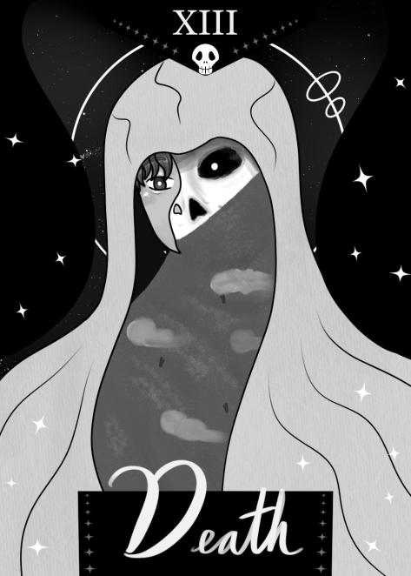
Original Concept
The original concept of the game was based around Tarot cards. We would have four playable characters that would fight against ghosts and collect spirit pieces. You would use AR to scan cards to give the player an ability like a speed boost or a higher jump.

Slide 4

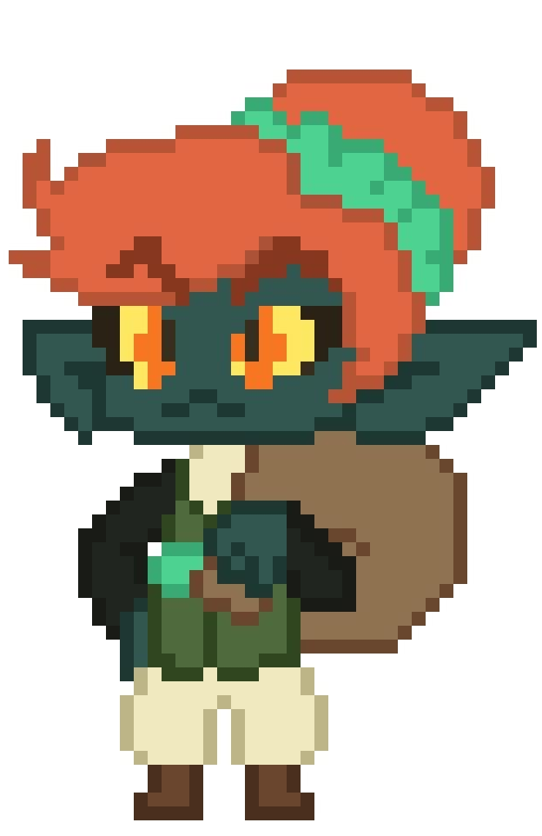
Original Concept
The playable characters would be based off of the four main suits in a Tarot deck. Swords, Wands, Pentacles, and Cups. All of the characters would work the same, but just look different for cosmetics. You would choose a character by using an AR button.

Slide 5
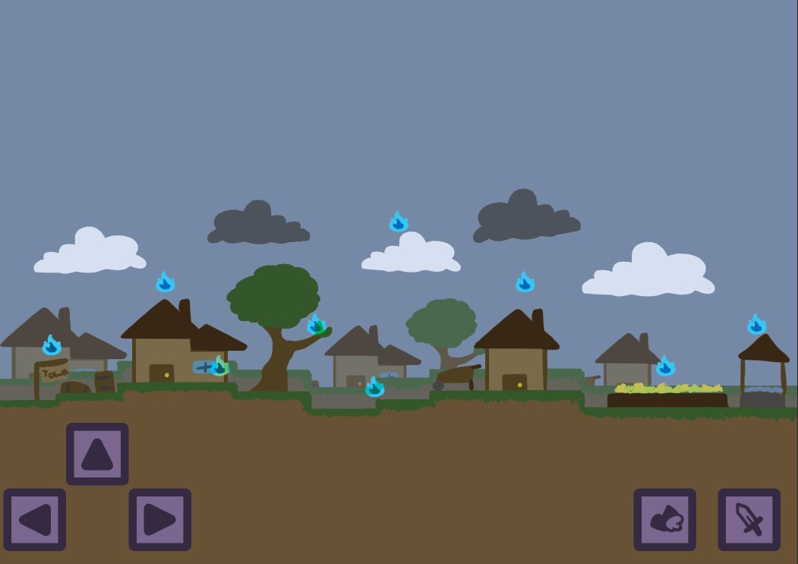
Original Level Layout
For the first level, it would of been a small town with souls scattered all around. There would of been some sort enemy that would shoot at the player. Once all of the souls are collected, you could jump down the well to continue.

Slide 6
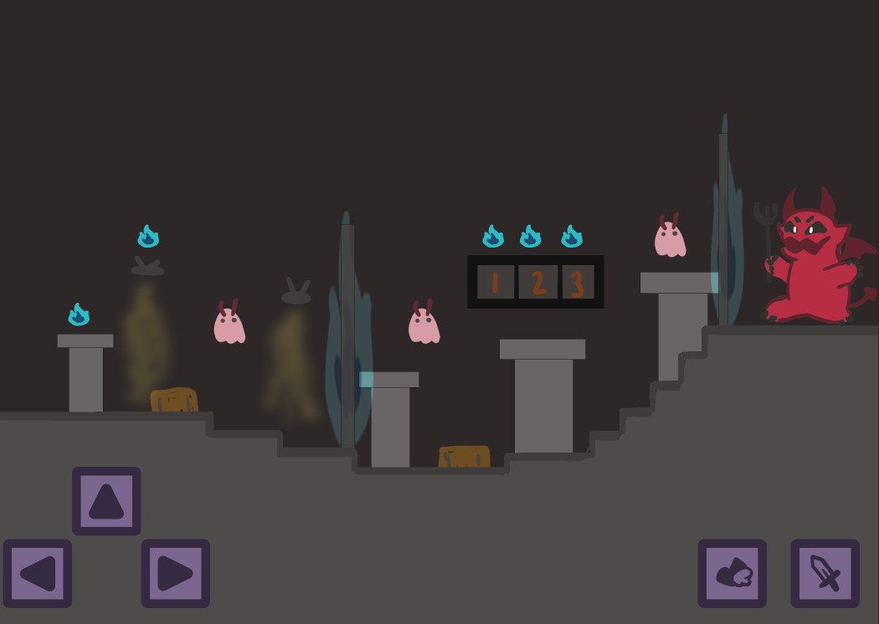
Original Level Layout
Once going down the well, you would end up the Devil’s dungeon. You would have to go through a battle gauntlet to face Satan. There was going to be a boss fight against Satan, but it was replaced by the gauntlet. You would finish the level by facing the Devil and handing over your collected souls.

Slide 7
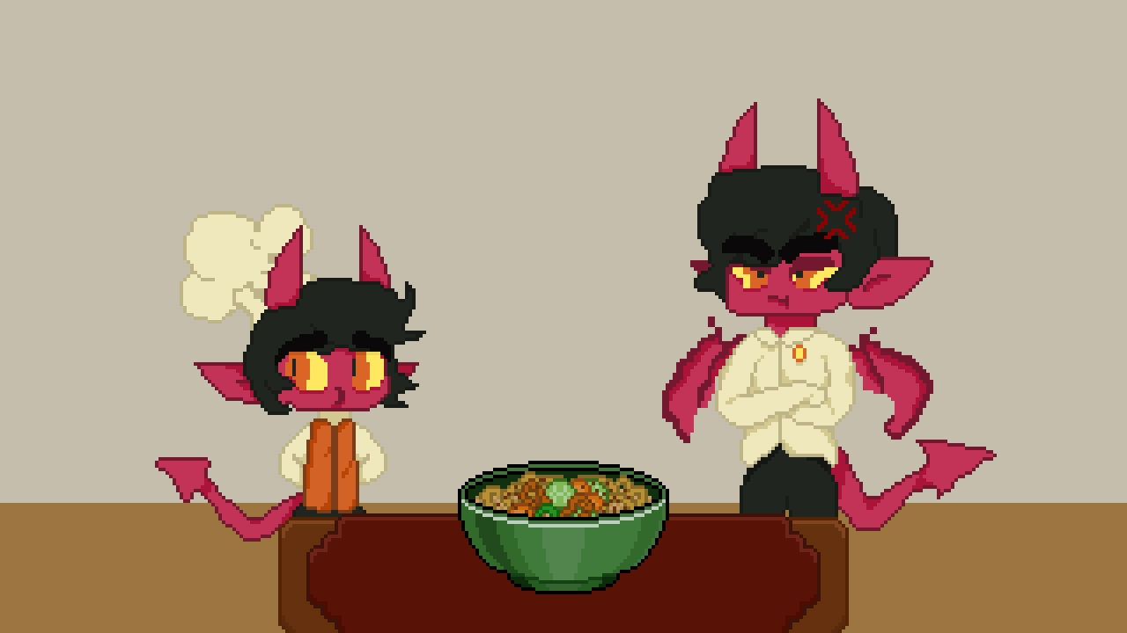
The Joke that Changed It All
While working on the level layout, we didn’t know what we would be collecting at first. As a joke, one of us had said soup. This became an ongoing joke. Once we had a meeting to discuss the game development, this soup joke had changed the game as a whole.

Slide 8
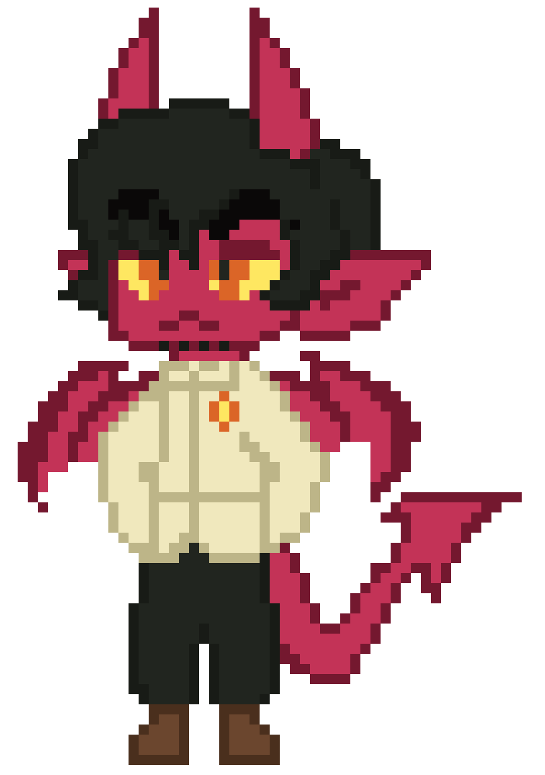
New Concept
Instead of going to face the Devil, he would now be your dad. Your dad is a master chef, and you want to impress him with your own cooking. You would now go around and collect ingredients to make a soup dish for your dad.

Slide 9
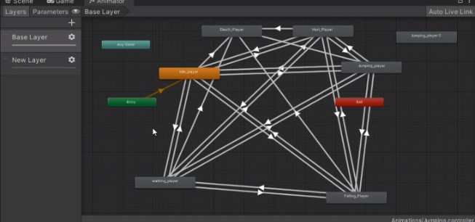
Animation
This shows the animator, which allows animations to switch to each other. These are all for the player’s movement animations.

Slide 10
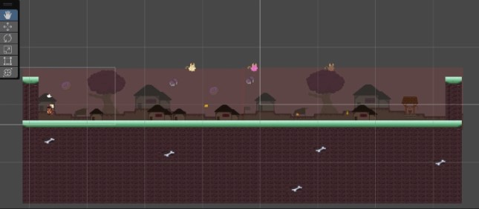
Level 1
This is the new layout for the first level. It was made more spooky and red to fit the new theme of the devil. This village is the town of the little ingredients you are collecting.

Slide 11
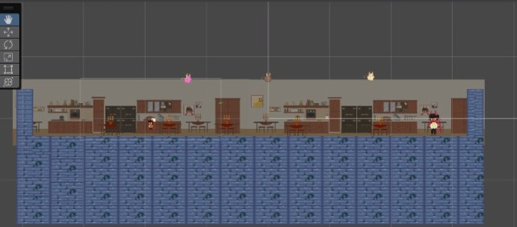
Level 2
Level 2 has you traveling in your dad’s kitchen. This is where you will continue collecting ingredients and show off your soup to your dad.

Slide 12
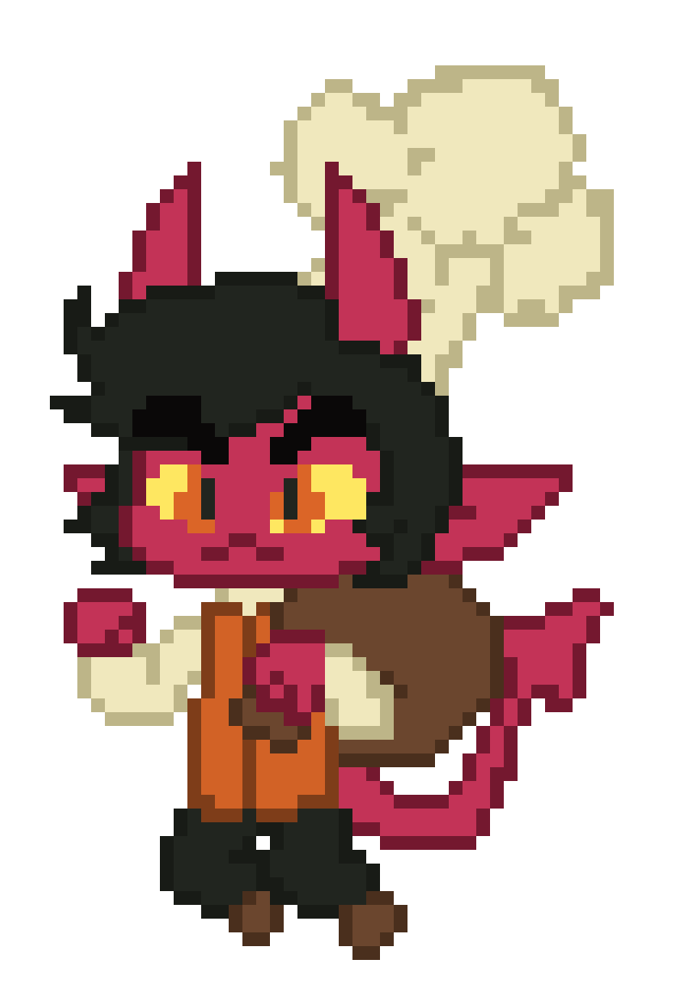
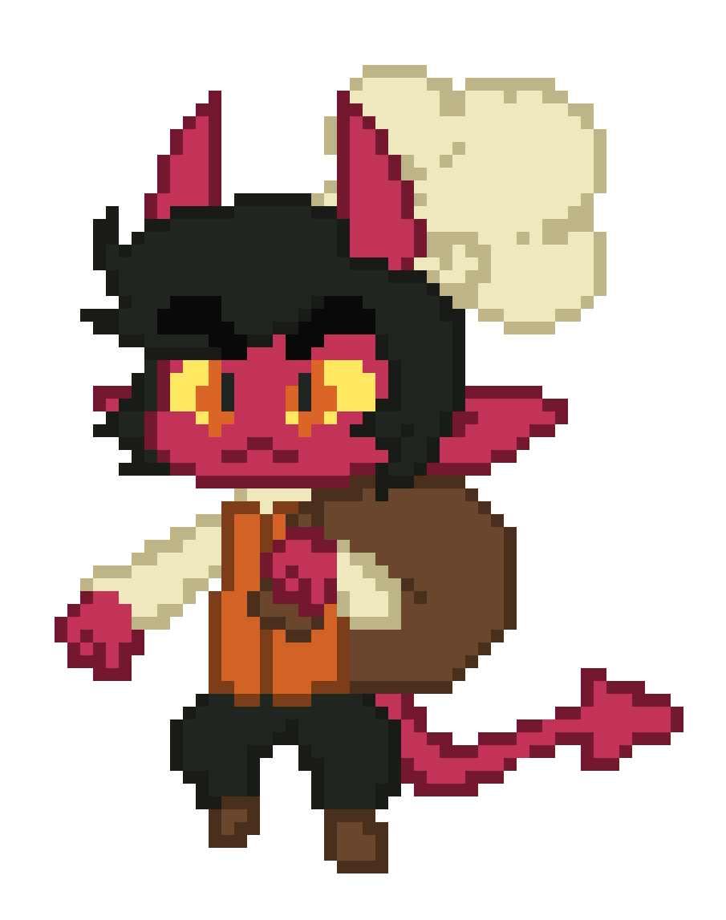
Mechanics
While playing, you have multiple movement options. You can press jump twice to do a double jump. Holding the jump button down longer to jump higher. Pressing left shift allows you to do a quick dash.

Slide 13
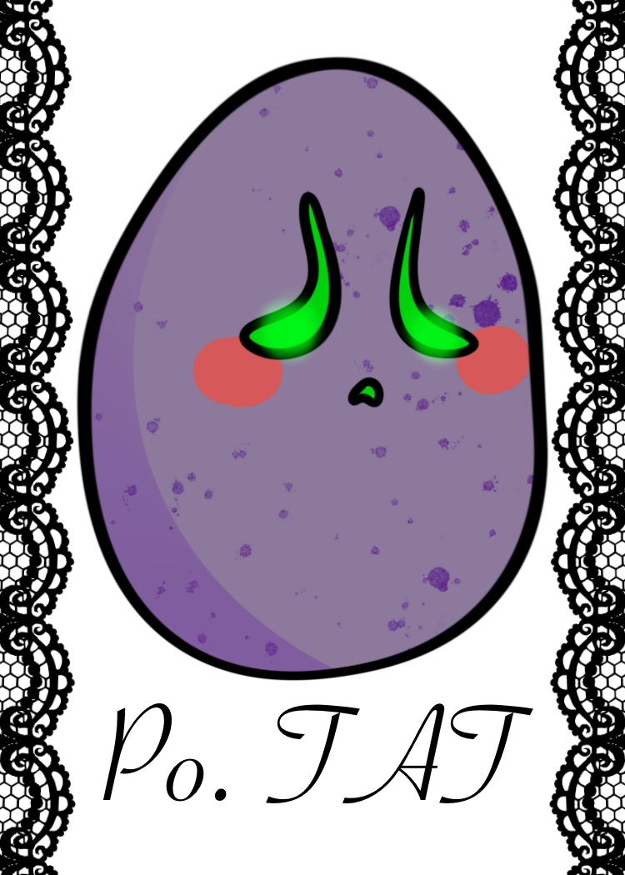
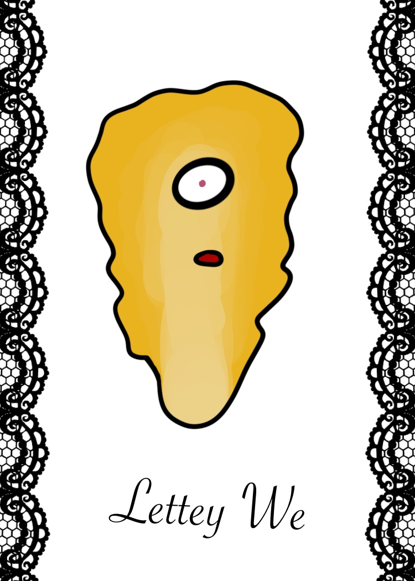
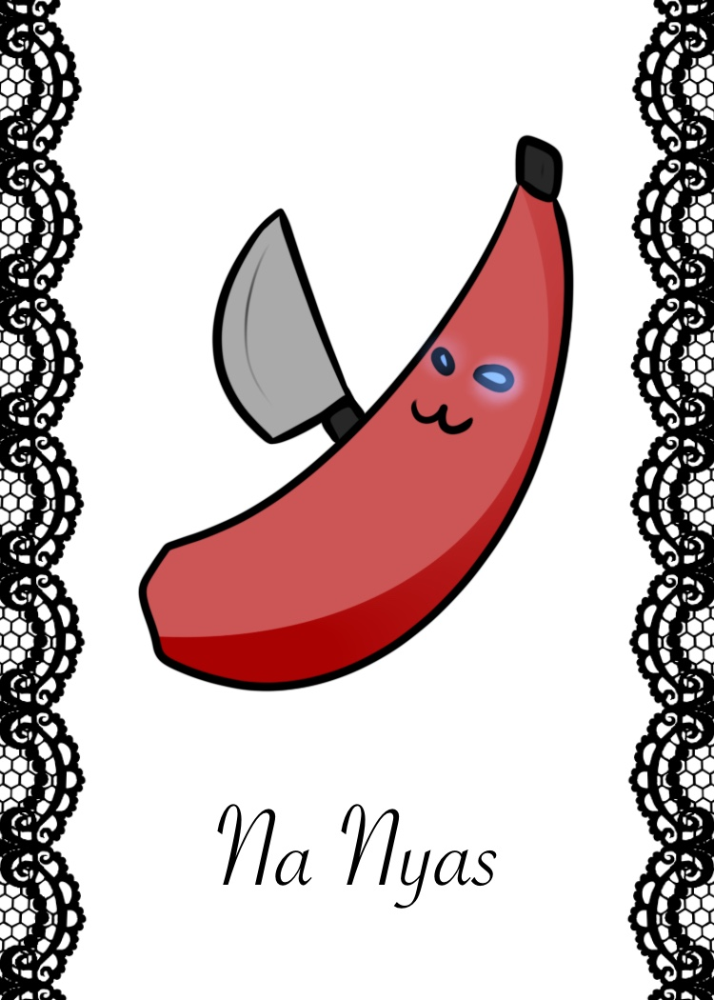
Cards
When you touch an ingredient, you’ll be taken to an AR section where you scan one of these three cards. You will play rock paper scissors to see how fresh your ingredient is.
Rock
Paper
Scissors

Slide 14
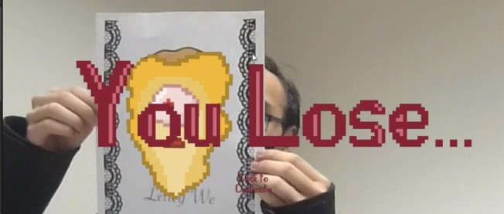
AR Elements
When holding up a card, you will either win or lose. If nothing shows up,that means it’s a tie. You can scan a new card, or scan the same card to retry.

Slide 15
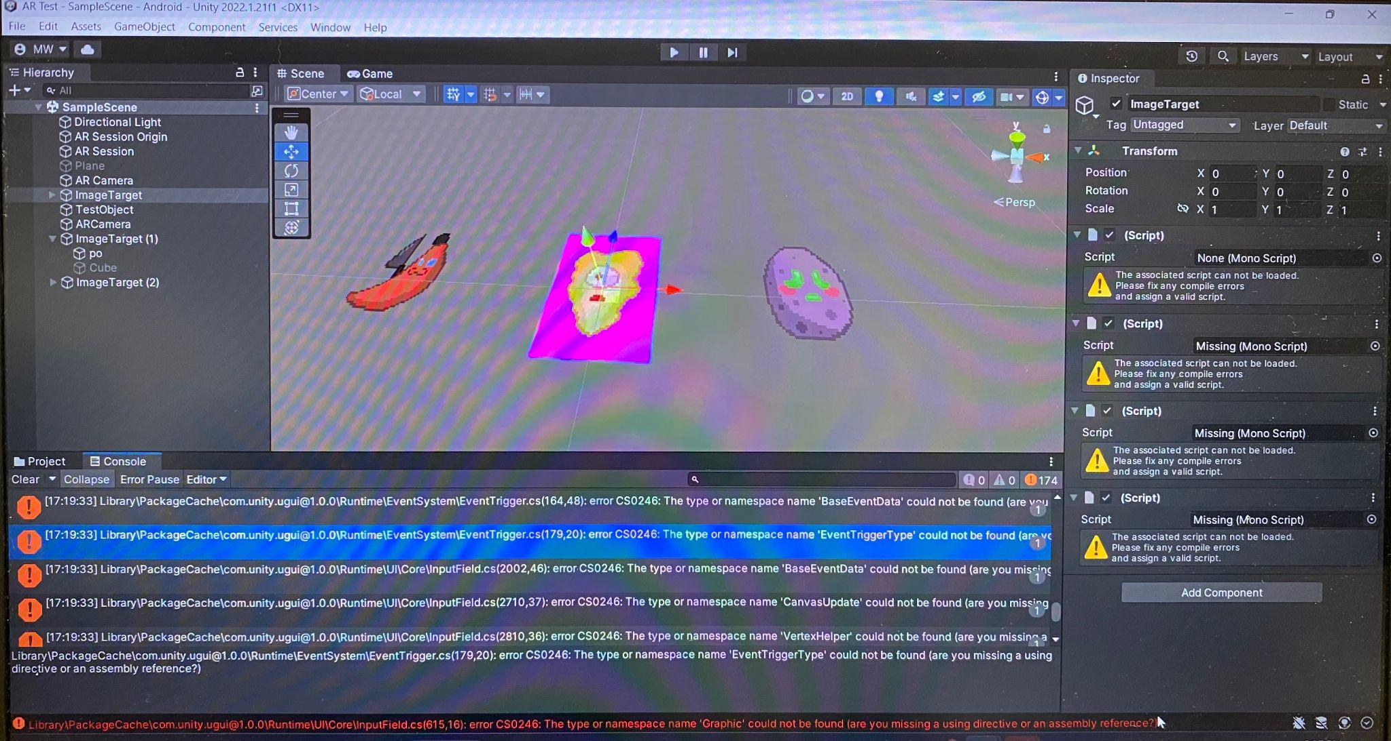
The Calamity
Once we had finished making the AR elements, we were going to put them into the game. We tried to make a copy of the file, but it was deleted instead. Once the file was found again, a copy was made. Opening up this copy showed that it was corrupted beyond fixing. Luckily the original file was untouched and fully functional.

Slide 16
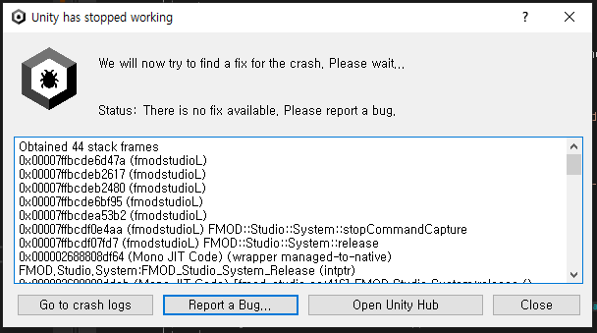
AR Troubles
Once we got the AR and platformer sections of the game in the same file, we still had errors with the AR. The main script that would activate the rock paper scissors gameplay wouldn’t activate when scanning a card. The card would be scanned, since an image would appear on the card, but nothing else would happen. After messing around with the code, we got the tie part to work, winning and losing would cause the game to crash. We later found out this was because the AR was deactivated while running the AR scripts. This was fix by turning off the AR after scanning the card and clicking the screen.

Slide 17

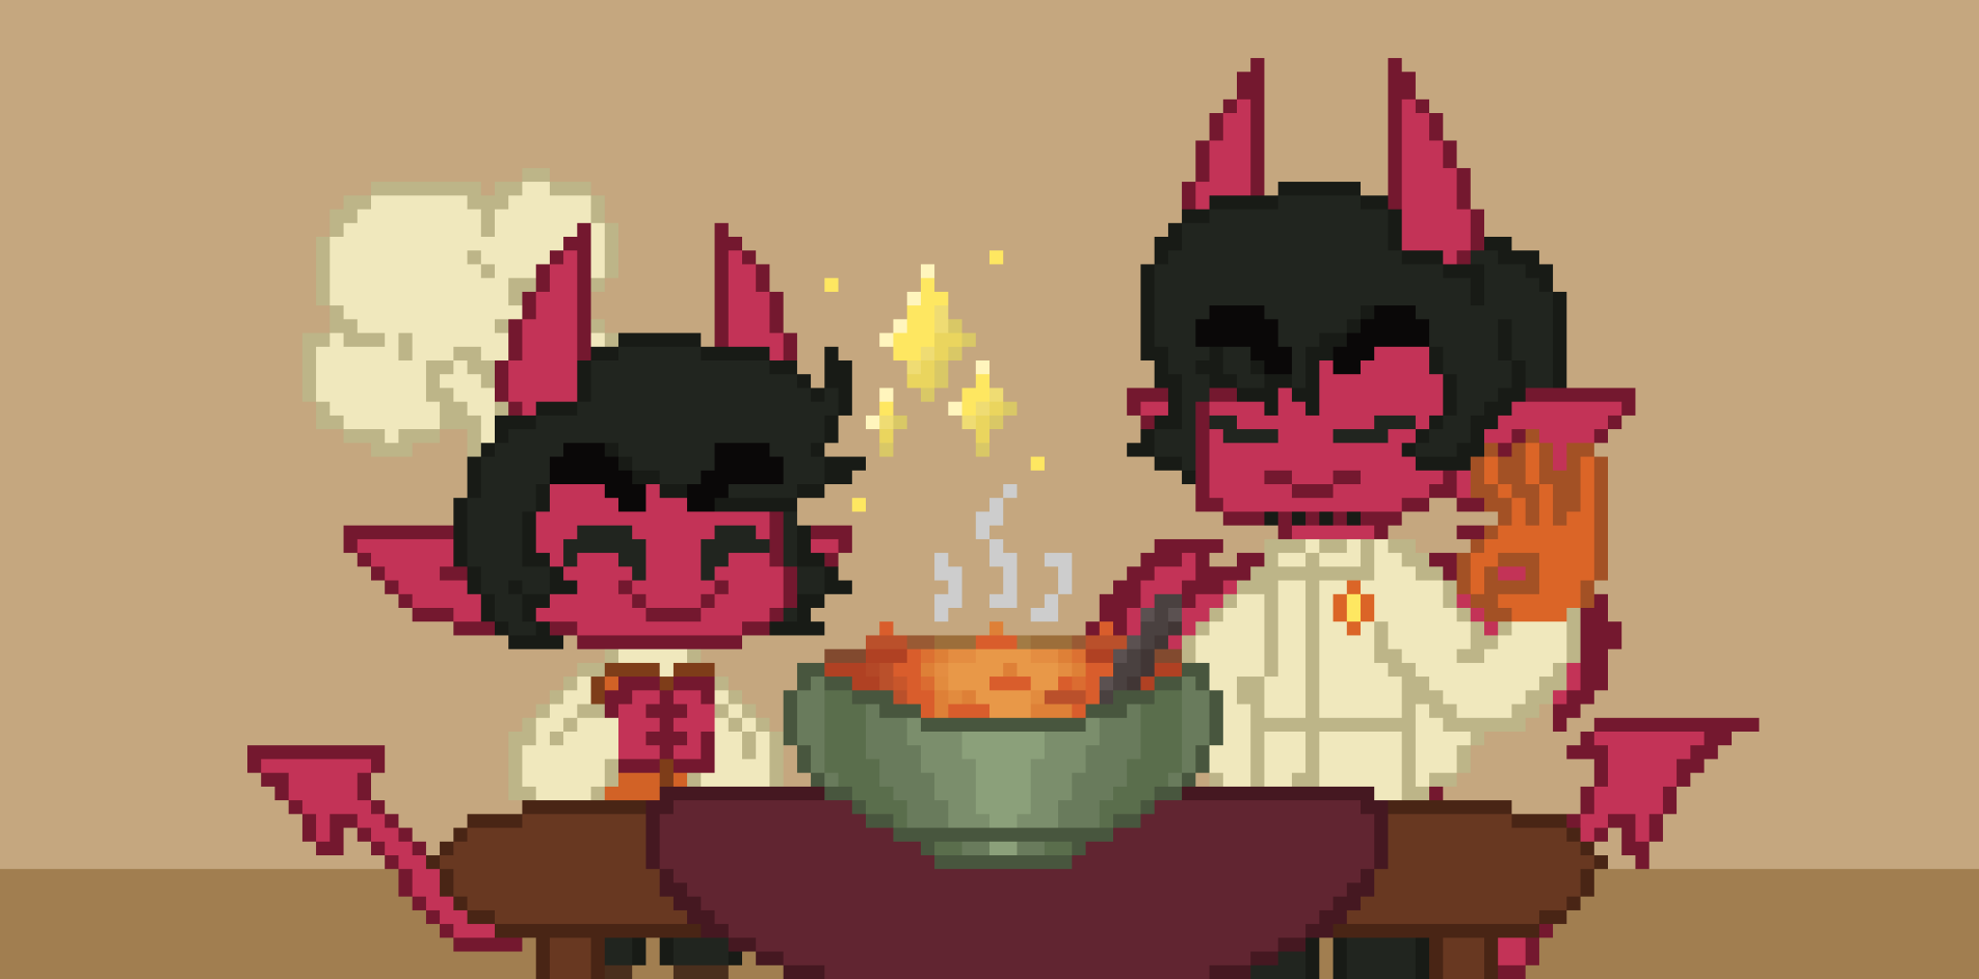
Beating the game
Neutral End (Win and Lose multiple matches)
As you finish the game by running up to your dad, you can get one of three endings. These depend on how many times you win or lose the rock paper scissors matches.
Good End (Win all matches)
3rd ending screen
Bad End (Lose all matches)

